Slide 1
A Summer’s Tale!
A Summer’s Tale!
A Summer’s Tale!

Slide 2
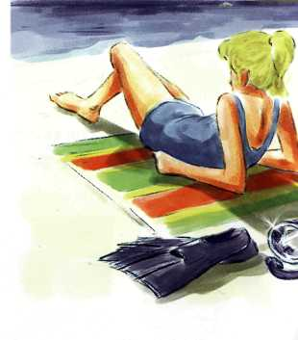
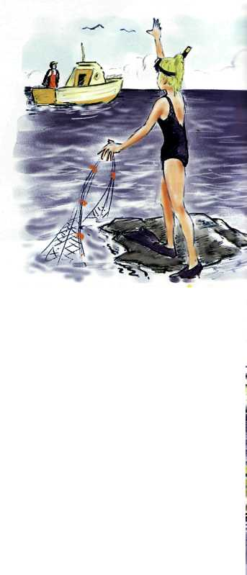
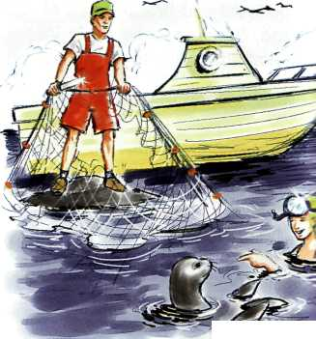

Slide 3
The pictures tell a story. Look at them and point to the following things: flippers, mask, knife, seal, net, rock, beach, fishing boat. Now, answer the questions below.
1
What did she see in the water?
What did she do then?
What happened at the end of the story?
Who was involved in the story?
Where was the girl?
What was the weather like?
How did the girl feel?
Why did the girl get into the water?

Slide 4
2
Read the story below and write the topic of each paragraph in the bubbles provided.
…description of events before the main event .. ending (feelings and reactions)
…setting the scene (who-where –when-what) ..description of the main event
It was a hot summer day and the sun was shining. Everything was calm and peaceful and Ann was relaxing on the beach. Suddenly, she heard a noise, like a baby crying. It was coming from the sea, so she put on her mask and flippers and went to have a look.
As soon as she got into the water, she swam towards where the sound was coming from. After she had swum a short distance, she saw a fishing net. Then she saw the seal. It was crying because it had got caught in the net. Ann tried to help it, but she needed a knife.
Just then she heard the engine of a boat. She climbed onto a rock and saw a small fishing boat. She needed help quickly, so she started to wave. When the man in the boat saw Ann, he came immediately to help her. He had a knife, so together they cut a hole in the net. Two minutes later, the seal was free.
Before the seal swam away, Ann played with it for a while. They swam together in the calm blue sea and Ann felt really happy. Finally, when the seal decided to leave, Ann shouted to her new friend, "Good luck! 1 hope I'll see you again soon!"

Slide 5
When you write stories, use adjectives to describe the weather and atmosphere. e.g. It was a hot, summer day. (weather) Everything was calm and peaceful, (atmosphere)

Slide 6
Decide which of the adjectives below describe weather and which describe atmosphere and complete the tables.
3
strange, wet, cloudy, magical, sunny, windy, still, silent, foggy, noisy, calm, rainy
wet strange
Now use the adjectives to make up sentences of your own, as in the example.
e g. It was snowing and everything outside was silent.
weather
atmosphere

Slide 7
We use the past simple to talk about actions which happened at a specific time in the past. We use the past continuous to talk about an action which was happening at a specific time in the past, e.g. It was a hot summer day and the sun was shining. Suddenly, she heard a noise

Slide 8
Put the verbs in brackets into the past simple or the past continuous.
4
It_____(rain) heavily and Pete _____(drive) very fast when he _____(have) an accident.
It ______(snow) heavily and the children _____ (make) a snowman outside. Suddenly, a bright light_____(appear) in the sky.
One day, while I______(sit) in the garden, I ______(hear) a strange noise. It___(come) from the apple tree, so I ___(go)
to have a look.
The sun ___(shine) and the birds _____(sing) so we_____(decide) to go for a picnic.
The wind ____(blow) through the trees and the wolves ____(howl) outside. Sandra ______ (feel) really scared!

Slide 9
We use the past perfect to describe an action which happened before another action in the past, e.g. After she had swum a short distance, she saw a fishing net.

Slide 10
Put the verbs in brackets into the correct tense: present perfect or past simple.
5
He ...phoned... (phone) the garage because his car ...had broken down... (break down).
2 She …..(wash) the dishes after she …...(finish) her meal.
3 Paul ….. (go) to the doctor because he ….. (hurt) his leg.
4 As soon as they …..(do) their homework, they …..(go) out
to play.
5 The train …..(leave) two minutes before Pam …..(arrive)
at the station.
6 I ….. (get) wet because I….. (forget) to take my umbrella.

Slide 11
Read the short texts below and put the verbs in brackets into the past simple, past continuous or past perfect.
6
The Ross family 1)……(sit) in the kitchen and Mrs. Ross 2)…..(cook) breakfast when her son 3) ….. (walk) through the door. It 4)….. (be) his birthday and she 5) …..(promise) to buy him a new bike. After he 6) ….. (eat) his breakfast, she 7)…..(tell) him to go outside to the garage.
The band 1)…..(play) her favourite song and everyone 2)….. (dance). Alison's husband 3) …..(order) some champagne.
They 4)…..(start) drinking it slowly. Then she 5)…..(notice) that he 6) …..(hold)a small silver box in his hand.
It 1)….. (be) a cold wet night. Jonathon 2)…..(stand) by the window when he 3)…..(see) a strange light in the sky. Suddenly, he 4)….. (hear) a loud bang so he 5)…..(go) out onto the balcony. A strange object 6) ….. (land) in his garden!

Slide 12
We use time words (first, as soon as, after, then, etc.) in stories to make the order in which events happen clear to the reader. e.g. As soon as she got into the water, she swam ... After she had swum a short distance, she ... Then she saw the seal.

Slide 13
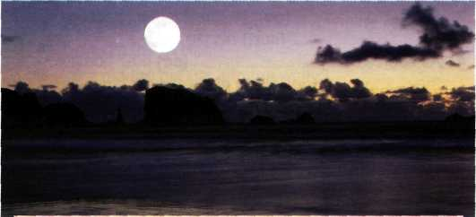

Slide 14
First read the story below and put the paragraphs in the correct order. Then, circle the correct time words.
7
Before/When they could do anything, something pushed the boat into the air from below. The next thing they knew they were in the water. Pam held on to Freddy and they swam quickly back to the shore. As soon as/When they looked back at the lake, nothing was there, not even their boat!
It was around midnight and there was a full moon over the lake. The sky was clear and the stars were shining brightly. The night seemed to be full of magic and mystery. Freddy and Pam had decided to go night-fishing.
They felt really puzzled about what had happened. It was a very strange experience and they still don't know what the thing in the water was. But there is a full moon again soon and they are planning to go back to the lake!
As/First they were rowing to the middle of the lake they saw a huge black shape in the water. Freddy had brought a torch with him so he pointed it at the strange thing. After/Then, suddenly, it disappeared under the surface.

Slide 15
Read the story in Ex. 7 again and underline - the sentence which describes the weather. -the sentence which describes the atmosphere. -the adjectives which describe feelings. -the sentence(s) which create(s) mystery or suspense.
8

Slide 16
Join the two columns below to make complete sentences. Now put the sentences in the correct order and try to tell the story.
9
He opened the door
Suddenly, there was a knock on the door
It was New Year's Eve
The man was a millionaire
The old man needed help
Tom was upstairs
getting ready
because he was going to a party.
and it was snowing heavily.
and saw an old man standing there.
because he had got lost in the snow.
so Tom went downstairs and opened it.
so he gave Tom a large
reward for helping him.

Slide 17
CAN YOU WRITE A GOOD STORY? Test yourself by answering these questions
10
Which tense do we use to give background information?
A past simple В past continuous С past perfect
Which paragraphs make up the main body of a story' A 1 and 2 В 3 and 4 С 2 and 3
Which paragraph describes the main event?
A the third В the second С the first
Which paragraph sets the scene?
A the second В the third С the first
Which tense do we use to describe an action which
happened before another action in the past?
A past perfect В past simple С past continuous
We never end a story by ...
A writing “THE END” at the bottom of the page.
B creating mystery or suspense. C using direct speech.

Slide 18
When you write a story, divide it into four paragraphs Begin your story by setting the scene (who, where, when, what, etc). In the second paragraph, describe the events which happened before the main event. In the third paragraph, describe the main event. End your story by describing people's feelings or reactions. You can use direct speech and a variety of adjectives to make your story more interesting to the reader. In stories we normally use past tenses. We also use time words (first, then, after, etc) to narrate the events in the order in which they happened.

Slide 19
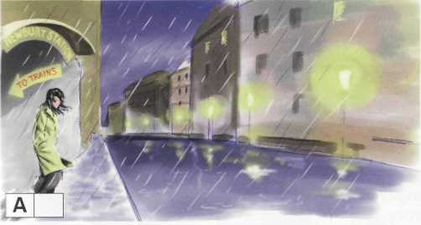
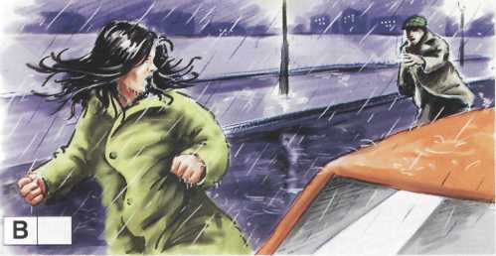
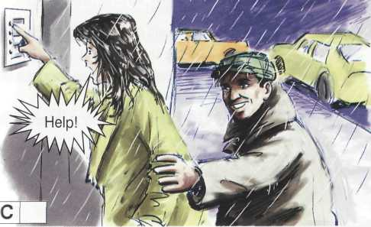
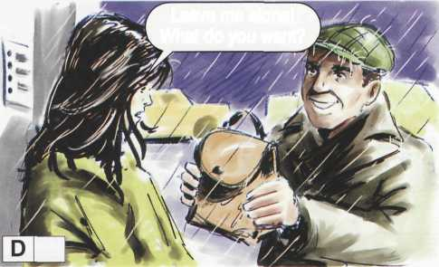
Match the sentences to the pictures below.
11
Jennifer ran to the first door, rang the bell and shouted.
2.It was a cold, dark evening and the streets were empty.
3."Don't worry! You left your handbag on the train!" the man explained.
4.Then, she heard footsteps behind her.

Slide 20
First, answer the following questions, then tell the story by looking at the pictures.
12
What was the weather like?
Who was involved in the story?
Where and when did the story take place?
What did she see when she looked over her shoulder?
How do you think she felt?
What did she feel on her arm?
What did the man say?
What do you think happened at the end of the story?

Slide 21
Use the information from Ex. 11 and the plan below to write a story entitled A Stranger in the Night.
13
Plan
Paragraph I set the scene
(who, where, when, what)
Paragraph 2 describe the events which
happened before the main event
Paragraph 3 describe the main event
Paragraph 4 end the story (refer to people's feelings and reactions/use direct speech)

