Slide 1
Unit # 4
Seasons Change

Slide 2
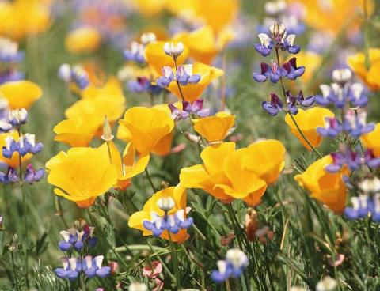
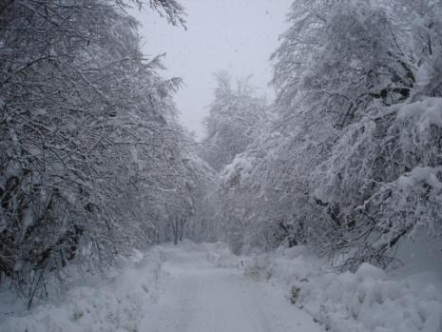
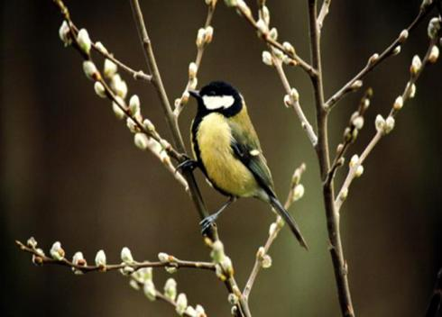
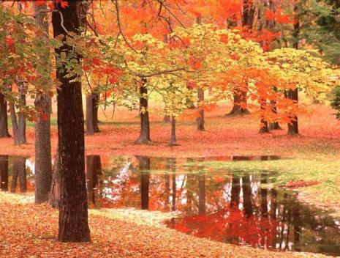
Match the pictures to the seasons. spring summer autumn winter

Slide 3
Which seasons do each of the following sentences describe?
It is very cold and it often snows.----
It is usually hot and sunny and we often go to the beach.----
It often rains, the leaves fall from the trees and we start school.----
It is often warm and sunny, but sometimes it rains. There are lots of flowers.----

Slide 4
Read Susan's article from an international teenager magazine about her favourite season, then read the sentences and mark them as T (true) or F (false).
Spring is Here!
► Spring is a wonderful season. If is my favourite season because every­thing is so beautiful and colourful.
► The weather is usually warm and sunny in spring. Beautiful flowers grow everywhere and the birds build their nests in the trees. However, the weather changes quickly. Sometimes, grey clouds appear in the sky and it rains, but after the rain, the sky turns blue again.
► In spring, I spend a lot of time outdoors. I often ride my bicycle and play with my friends in the park. The countryside is lovely in spring, so my family and I often go on picnics on Sundays.
► I love spring. It makes me feel happy and energetic.

Slide 5
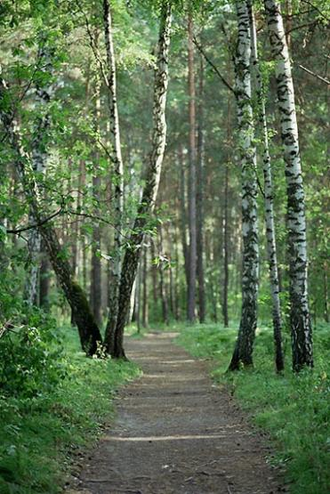
Read the sentences and mark them as T (true) or F (false).
Winter is a wonderful season.
The weather is usually cold and rainy.
Beautiful flowers grow everywhere.
Susan often rides her bicycle and plays in the park.
Spring makes Susan feel sad and lazy.

Slide 6
Which paragraph:
a. is about the weather and
what happens in spring?
b. is about Susan's feelings?
c. says which Susan's favourite season is?
d. is about what Susan does in spring?

Slide 7
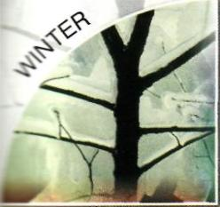
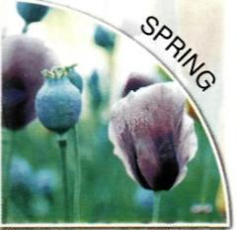
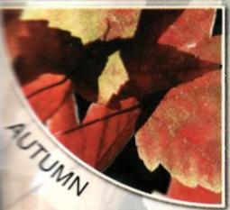
Look at the picture showing the seasons, and put the months from the list in the correct part of the picture, in the correct order.
February,
June,
March,
August,
April,
September,
May,
January,
October,
December,
November,
July

Slide 8
Match the words to their meanings
1 wonderful
2 build
3 beautiful
4 lovely
5 energetic
6 nest
A very nice
B make
C lively
D amazing
E birds' home
F very pretty

Slide 9
Fill in the gaps with words from the list. feel, turns, build, spend, picnics, ride
to ____nests
the sky ____ blue
to _____ a bicycle
to_____ happy
to go on_____
to _____ time

Slide 10
STUDY TIP We use the present simple to talk about repeated actions. E.g. In spring I play with my friends in the park. It usually snows in winter.

Slide 11
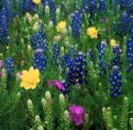
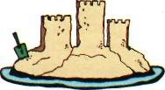
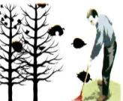
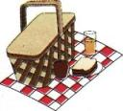
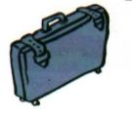
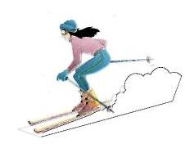
In which seasons do we do these activities? Write S (for summer), A (for autumn), W (for winter) or SP (for spring).
make a sandcastle
school starts
go on picnics
pick flowers
go skiing
go on holiday
make a snowman
collect the leaves from the garden

Slide 12
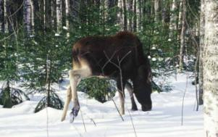
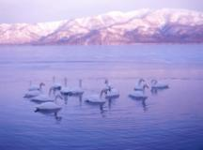
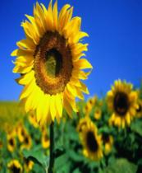
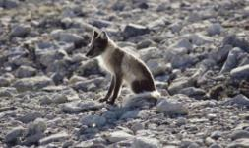
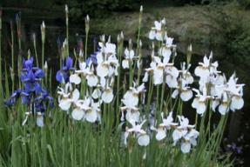
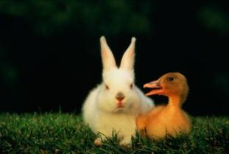
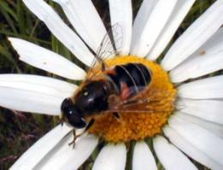
Think of some other things we do during each season and write them in the table.
WINTER
SPRING
SUMMER
AUTUMN

Slide 13
Use the prompts above and your own ideas to write two sentences about what you do during each season, as in the example
e.g. In the winter, I go skiing with my family.
make a sandcastle
school starts
go on picnics
pick flowers
go skiing
go on holiday
make a snowman
collect the leaves from the garden
winter
spring
summer
autumn

Slide 14
Complete the table, as in the examples.
the morning, noon, Wednesday, August, midnight, May, the summer, the weekend, the evening, Saturday, July, Tuesday, 10 o'clock, the autumn, the afternoon
In | The morning,
At | Noon,
on | Wednesday,

Slide 15
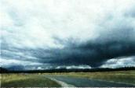
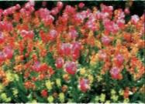
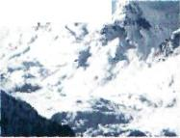
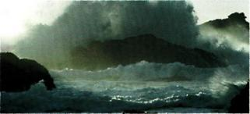
Look at the pictures, then use the adjectives from the list to complete the sentences, as in the example.
warm, cold, rainy, windy, sunny, hot, cool
It snows in winter. It ‘s cold.
In the spring, there are a lot of flowers.
The weather is not very hot. It's w…..
The sun shines a lot in the summer. It's h… and s….
In the autumn, the leaves fall from the trees.
The weather isn't cold. It's c…..

Slide 16
STUDY TIP
Adverbs of frequency (never, always, sometimes, often, usually, etc)
go before main verbs
e.g. I usually go on picnics with my family. but after auxiliary verbs and the verb to be.
e.g. You can often go skiing in winter.
It is usually hot in summer.

Slide 17
Look at the chart below and use adverbs of frequency to rewrite the following sentences about yourself. e.g. go swimming in the summer. I always go swimming in the summer.
Never
0%
Sometimes
20%
Often
60%
Usually
70%
Always
100%

Slide 18
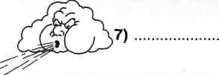
Look at the drawings and fill in the gaps, as in the example.
In winter, it is cold and 2)_ _ _ .
It often
3) _ _ _ and it sometimes
In summer, it is usually 4)
6) It is never cold,
but it is sometimes

Slide 19
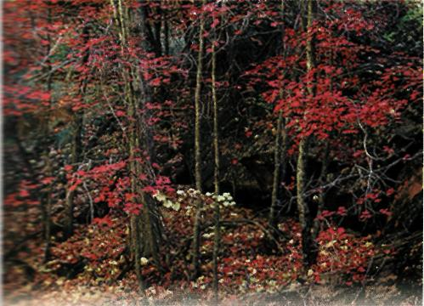
Read the text below and put the verbs in brackets into the present simple.
Autumn Changes
Autumn is a beautiful season. It is my favourite season because it's cool and the trees 1) ___(change)colour.
In autumn, it often 2)___(rain) and the wind 3)___(blow). Leaves 4)___(fall) from the trees and birds 5) ___(fly) to warm places.
In autumn, my mother always 6)___(buy) me a new bag, because school 7)___(start) in September. My father 8)___ (collect) the leaves from the garden. Sometimes I 9)___(help)
him after school. At the weekends we often 10)___(visit) my grandmother.
I 11)___(like) autumn very much.
It 12)___(make) me feel relaxed and happy.

Slide 20
Writing tip
When we write an article about our favourite season,
we start by mentioning the season and why it is our
favorite season.
In the second paragraph, we write about the weather and nature.
In the third paragraph, we say what we do during that season (in the morning/afternoon/evening, at the weekend).
In the last paragraph, we say how we feel.
We use the present simple because the article is about repeated actions/events. We also use adjectives to describe the weather and our feelings.

Slide 21
Read Paul's article from the school news­paper about his favourite season, and put the paragraphs in the correct order.
Wonderful Winter
I do lots of things in winter. I go to school in the morning. In the evening, I stay at home and watch TV or read a book next to a warm fire. When it snows, my friends and I go to the park and make a snowman. At the weekend, my family and I go skiing in the mountains.
Winter is a lovely season. It is my favourite season because everything is beautiful when it snows.
Winter is fantastic. It makes me feel happy.
The weather is very cold. It often snows and the sky is usually cloudy. Some animals sleep all winter. There are no leaves on the trees and there aren't any flowers.
A
B
C
D

Slide 22
Read the sentences below and under­line the correct words
In paragraph 1, Paul introduces his favourite weather / season.
Paragraph 2 is about the weather and nature / Paul's activities.
Paragraph 3 is about Paul's family / activities.
Paragraph 4 is about Paul's feelings / weekends.

Slide 23
Use the plan and the prompts below to write an article for your school newspaper with the title Summer is Great! (50-70 words).
Plan
Paragraph 1 say why summer is your favourite season
Paragraph 2 describe the weather and nature
Paragraph 3 say what you do/what happens
during this season
Paragraph 4 say how this season makes you feel
favourite season — beautiful, fantastic
weather and nature - hot, sun shines, sunny, aren't any clouds, trees, green leaves, birds sing, warm sea
activities — go on holiday, swim, make sand-castles, go on picnics, ride my bicycle
feelings — feel happy, lively, relaxed, energetic

